Slide 1
CLOUDERA DATA PLATFORM
All your data. One platform. Limitless possibilities.

Slide 2
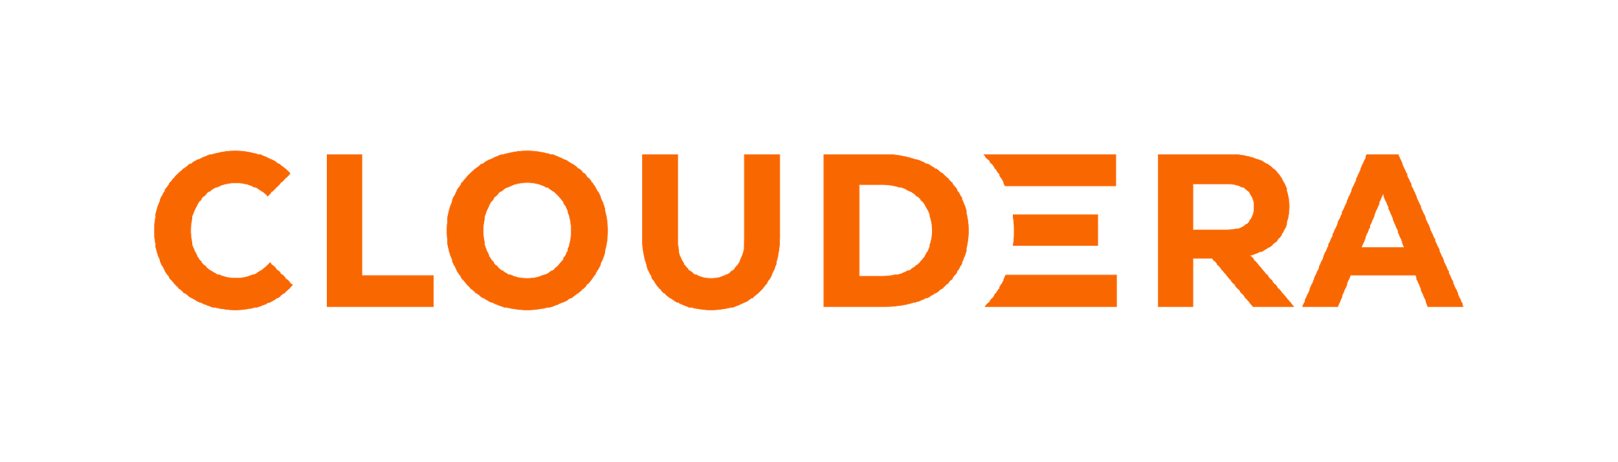
THE ENTERPRISE DATA CLOUD COMPANY
Cloudera proposes a hybrid data platform that provides end-to-end data management and analytics solutions for organizations that allows users to collect, store, process, manage, and analyze data of any size, shape, and type in a single platform from edge to AI.
We empower the largest enterprises to transform any data anywhere into valuable insights they can trust.

Slide 3
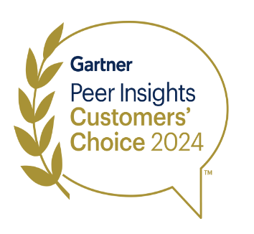


Cloudera Named Gartner Peer Insights (GPI) Customers’ Choice
Market average
Strong performer
Customers’ choice
Databricks
Snowflake
Cockroach Labs
Market & Market Size: Cloud Database Management Systems (DBMS) in Midsize ENT
Market average
Overall experience
Aspiring
Established
MongoDB
Neo4j
SAP
Amazon Web Services (AWS)
Google
Microsoft
Oracle
User interest and adoption
(Each quadrant is ordered alphabetically)
As of Mar 2024
©2025 Cloudera, Inc. All Rights Reserved.

Slide 4
CLOUDERA DATA PLATFORM
The ultimate flexibility in hybrid data management and data analytics.
DELIVER TRUE HYBRID
ENABLE MODERN DATA ARCHITECTURES
ACCELERATE
ENTERPRISE AI
Reduce cost, complexity, and risk with advanced analytics and AI at scale, across any cloud or data center.
Securely protect, streamline, and deliver data and AI quickly with an open data lakehouse.
Rapidly deploy trusted AI by bringing any model to your secured and governed data
Scalable and secure data management with portable, cloud-native data services
Whether you're powering business-critical AI applications or running real-time analytics at scale, we enable you to securely derive value from all your trusted data anywhere.

Slide 5
CLOUDERA DATA PLATFORM
Unlock the potential of data on premises and in the cloud with the industry’s only true hybrid data, analytics, and AI platform.

Slide 6
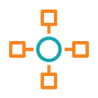
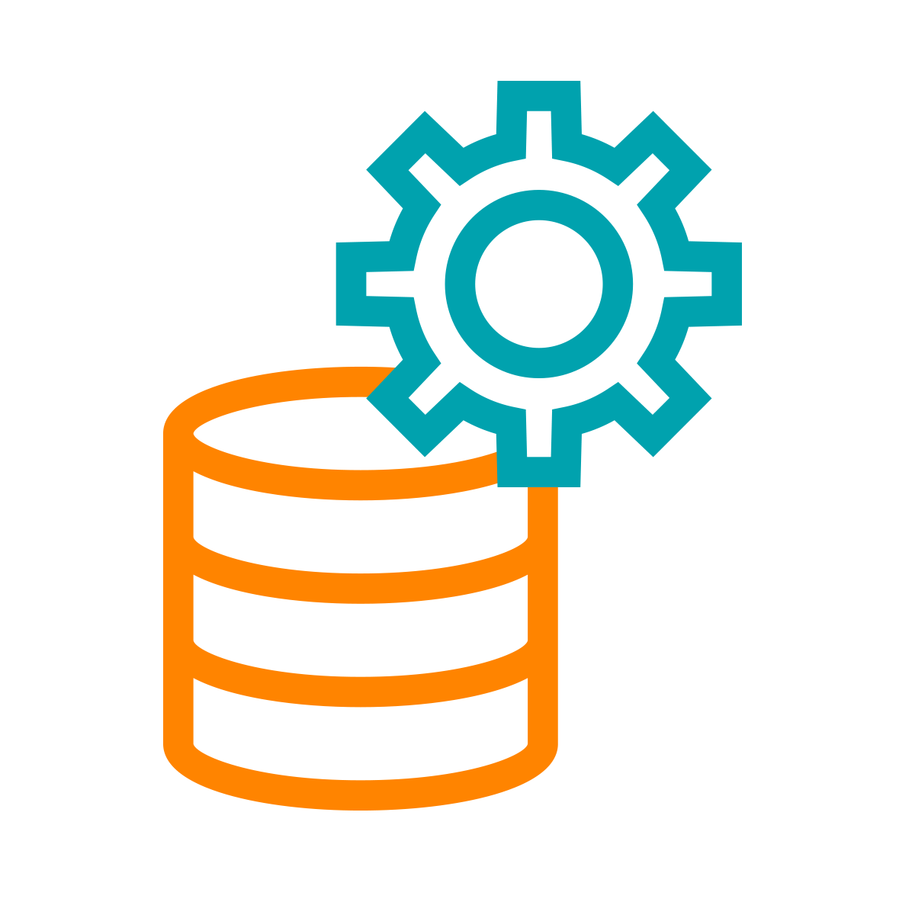
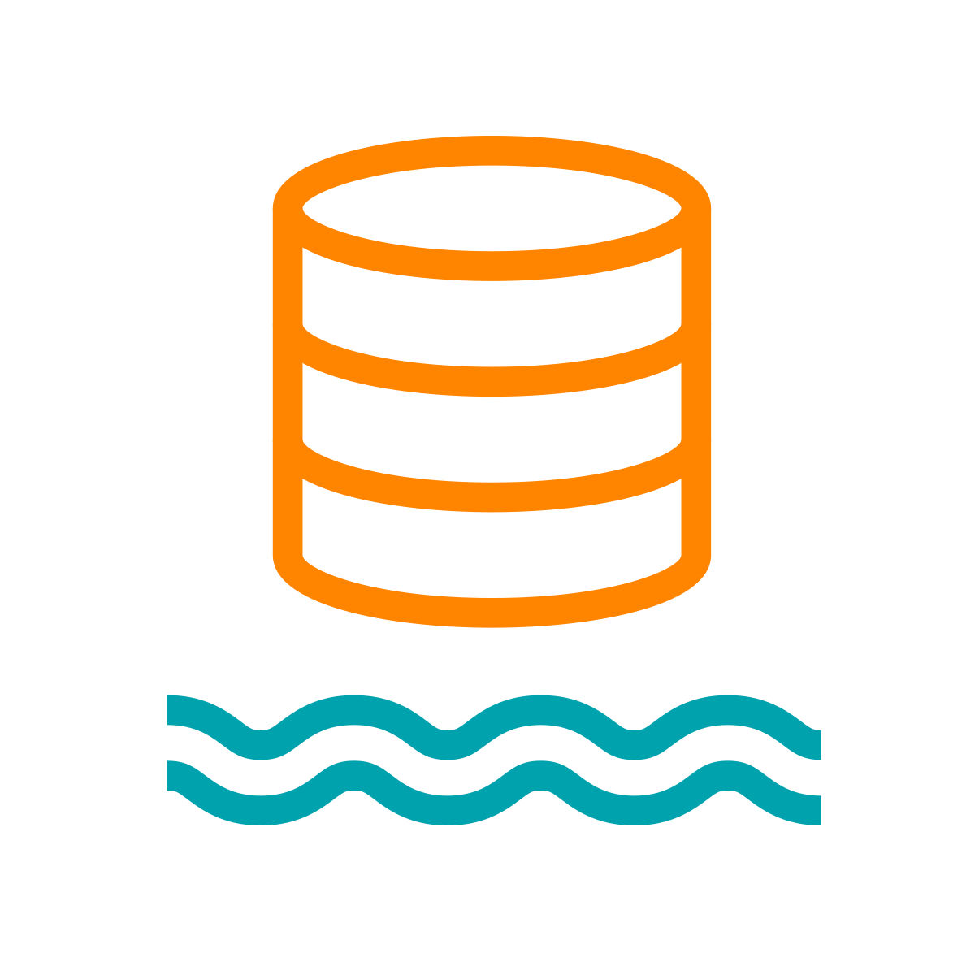
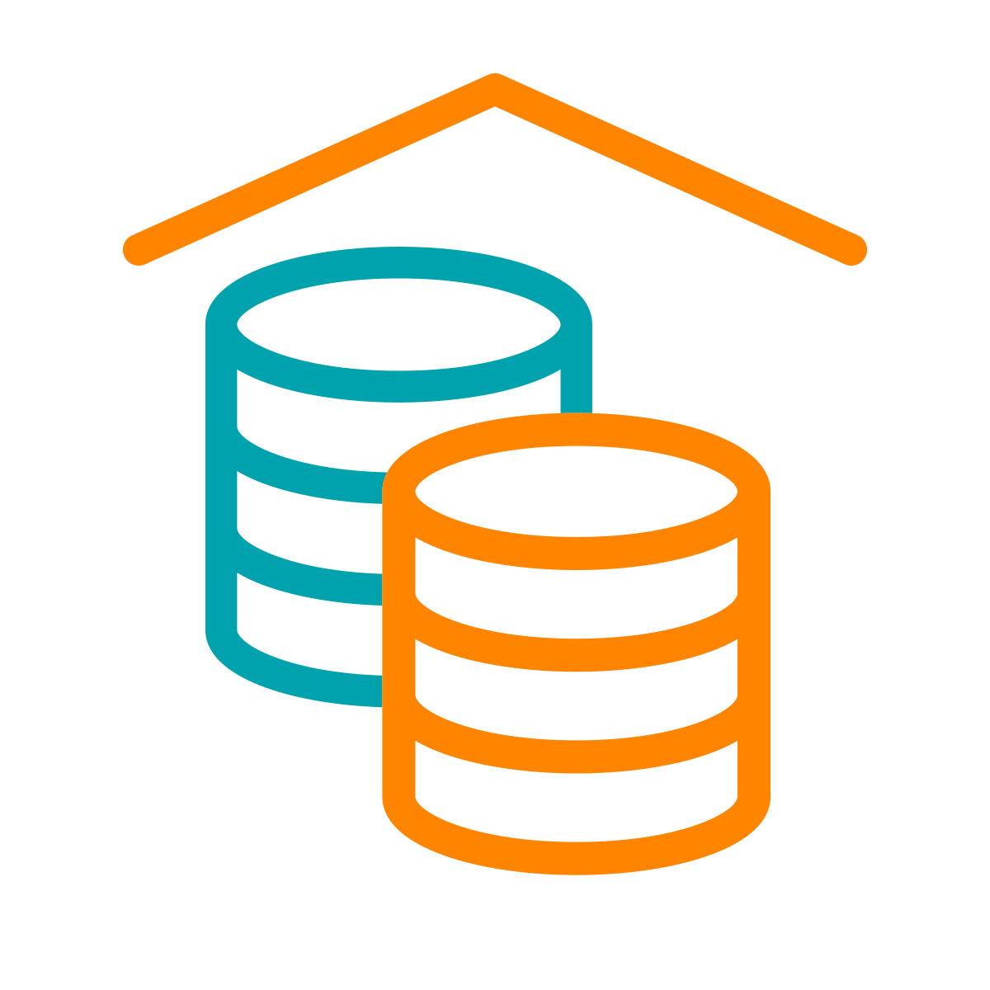
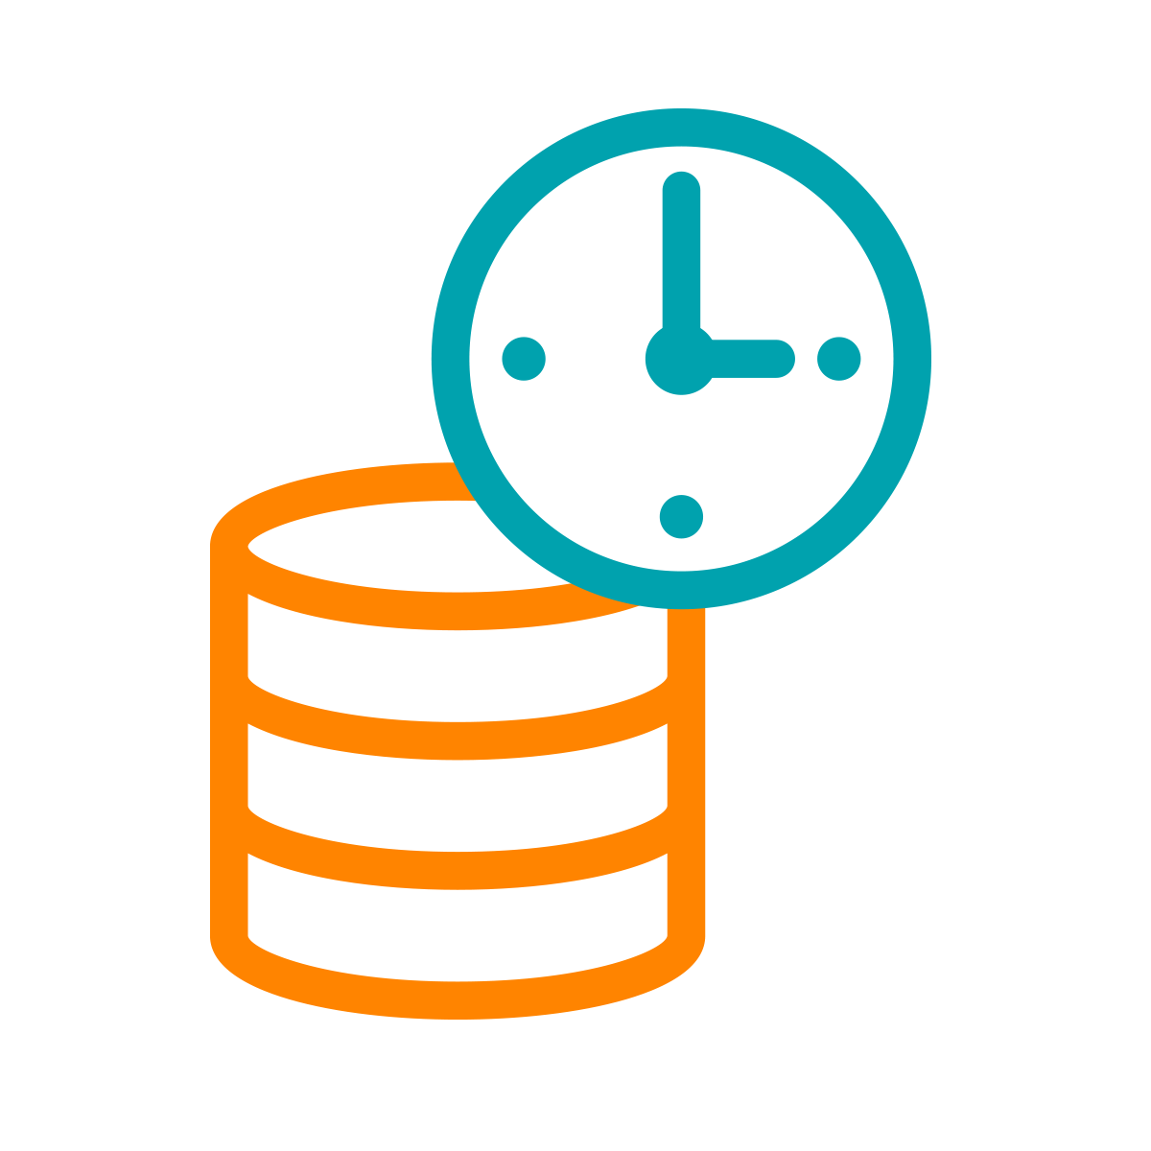

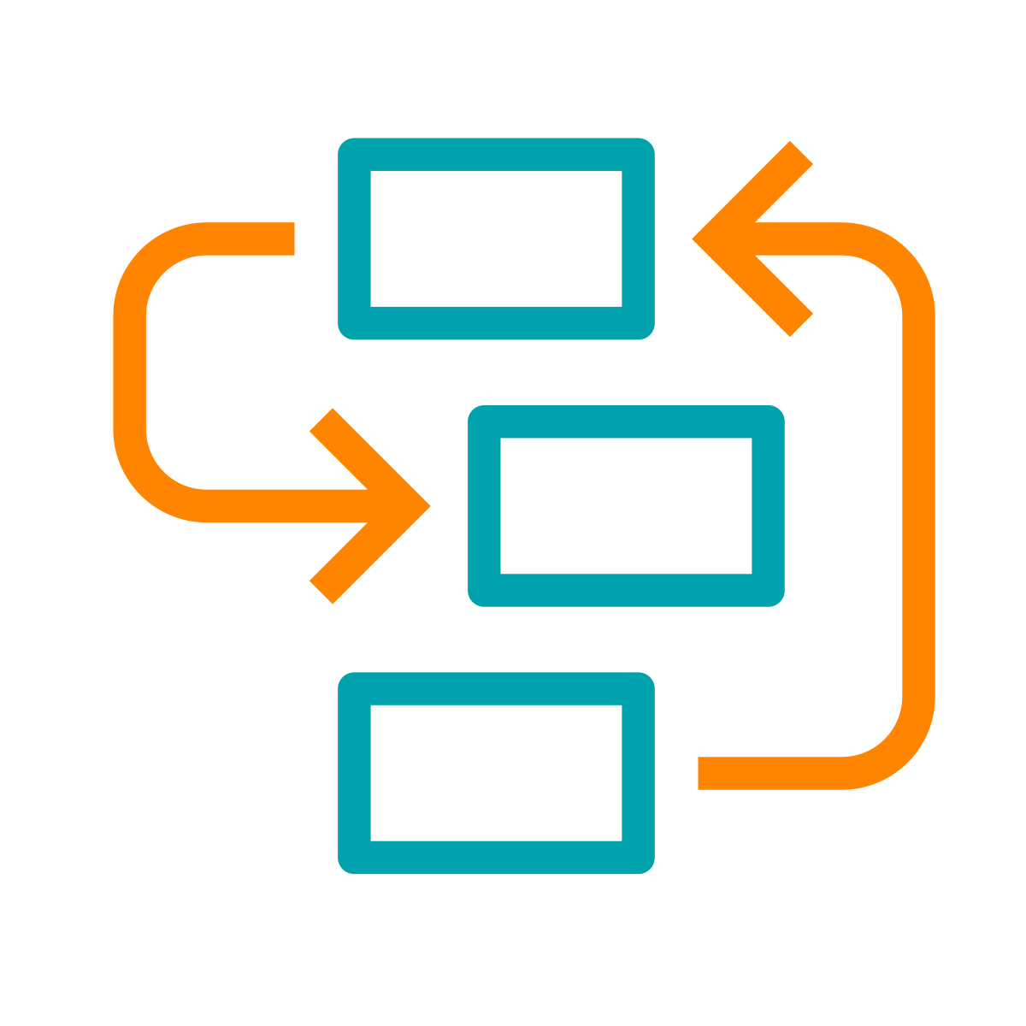
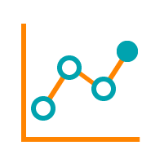
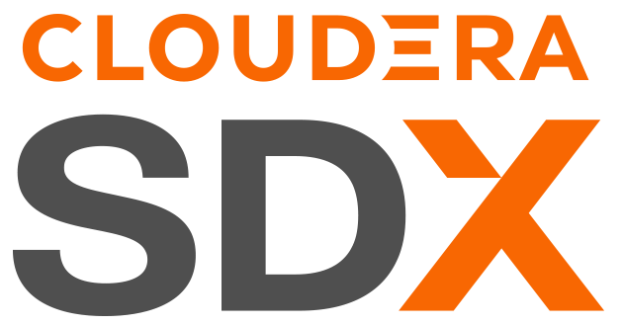




A HYBRID DATA PLATFORM AND AN INTEGRATED SUITE OF SECURE ANALYTIC APPS
Real-time
Batch
Structured
Unstructured
Data Collection
Data
Engineering
Virtual Data Lake
Data Warehouse
Operational Database
Streaming Analytics
Machine Learning & AI
Data Visualization
Analysts
Engineers
Scientists
Developers
Data Sources
Data Users
Cloudera Data Platform
Data Lifecycle integration for better user productivity and faster time to value
Hybrid & Multi-Cloud to leverage existing investments and reduce risk
Secure & Governed to simplify data protection, sharing and compliance
Open & Extensible to support more use cases faster and at lower cost

Slide 7
Cloudera on Premises – PRIVATE CLOUD
NDA
On-premises data and analytics platform by offering faster analytics, improved hardware utilization, and increased storage density.
DATA CATALOG | MANAGEMENT CONSOLE | REPLICATION MANAGER** | OBSERVABILITY**
Cloudera Data Services on premises***
Access to Data Engineering, Data Warehouse and Machine Learning
Runs on Packaged ECS; supports Openshift (BYOL)
Uses Base for SDX and Data
Data Visualization
DATA SERVICES
DATA ENGINEERING
DATA WAREHOUSE
MACHINE LEARNING
METADATA | SECURITY | ENCRYPTION | CONTROL | GOVERNANCE
Cloudera Base on premises
Deploy traditional Data Clusters
Shared Data Experience (SDX), advanced security and governance
Data Management (HDFS, Ozone, Kudu, Kafka, 3rd Party or NFS)
Cloudera Manager
Observability Add-On (for PVC Base workloads) - sold separately
DATA CLUSTERS
Data Under Management
HDFS, OZONE, KUDU, KAFKA, 3RD PARTY, NFS, ETC
NiFi*, Kafka, Flink*, Spark, Impala, Hive, HBase, Phoenix
CLOUDERA BASE
* Standalone SKU
** Available on Cloudera Base
***Cloudera Base is a prerequisite for Cloudera Data Services

Slide 8
Cloudera on Cloud – PUBLIC CLOUD
NDA
Integrated analytics and data management platform deployed on cloud services
Cloudera Data Services On Cloud
Access to Data Flow, Data Engineering, Data Warehouse, Operational Database and Machine Learning
Runs on Cloud IaaS; supports AWS, Azure, GCP(BYOL)
Data Visualization
DATA CATALOG | MANAGEMENT CONSOLE | REPLICATION MANAGER | OBSERVABILITY*
DATA SERVICES
DATA ENGINEERING
DATA WAREHOUSE
MACHINE LEARNING
*CDF, COD, and DataHub available as add-ons
METADATA | SECURITY | ENCRYPTION | CONTROL | GOVERNANCE
Cloudera Virtual Private Cluster
VM-based Data Lake
Data Hub Cluster for On-demand workload
Data Under Management (S3, ADLS, GCS)
DATA CLUSTERS
Data Under Management
S3 | ADLS | GCS
NiFi†, Kafka, Flink, Spark, Impala, Hive HBase, Phoenix
CLOUDERA PUBLIC CLOUD
† Flow Management or DataFlow rate card
* Standalone SKU

Slide 9
ONE PLATFORM – TWO FORM FACTOR
NDA
Consistency and flexibility for data analytics across private & public clouds
CLOUDERA HYBRID CLOUD
MANAGEMENT CONSOLE | DATA CATALOG | REPLICATION MANAGER | OBSERVABILITY*
DATA SERVICES
DATA SERVICES
DATA ENGINEERING
DATA WAREHOUSE
AI
DATA ENGINEERING
DATA WAREHOUSE
AI
METADATA | SECURITY | ENCRYPTION | CONTROL | GOVERNANCE
DATA CLUSTERS
DATA UNDER MANAGEMENT
DATA CLUSTERS
STORAGE
S3 | ADLS | GCS
NiFi*, Kafka, Flink*, Spark, Impala, Hive, HBase, Phoenix
NiFi†, Kafka, Flink, Spark, Impala, Hive HBase, Phoenix
CLOUDERA ON PREMISES
CLOUDERA ON CLOUD
* Standalone SKU
† Flow Management or DataFlow rate card

Slide 10



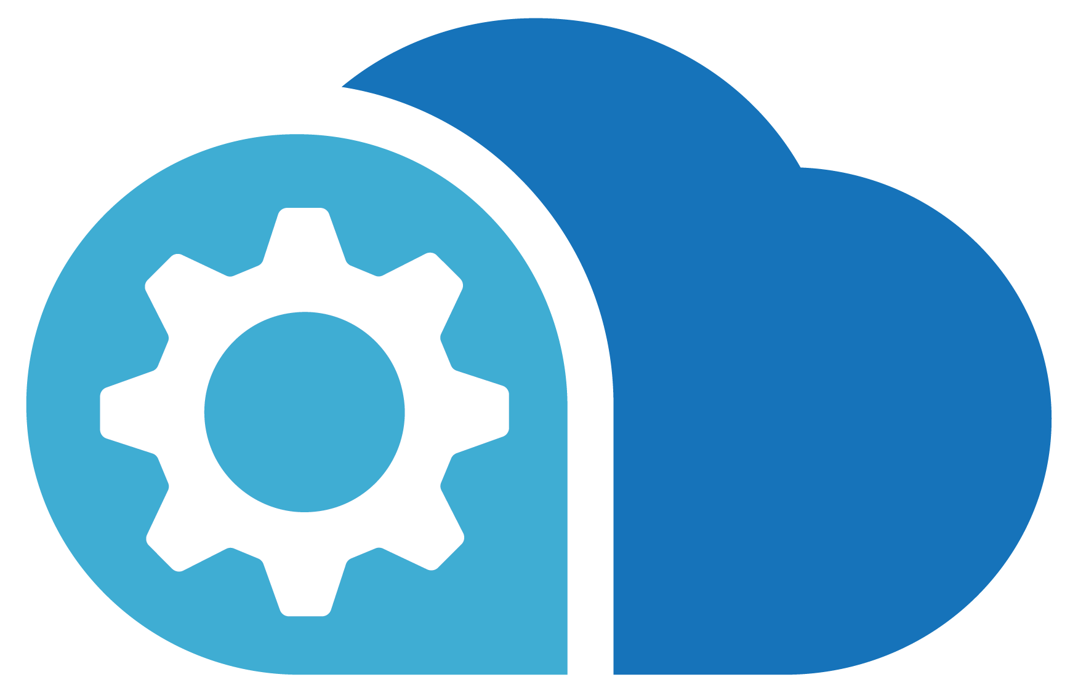

High Level Enterprise BIG Data Architecture
Real-Time Data and Steaming Data
Real-Time / Steaming Data / Steaming Processing
Visualize, Interact, Self-Serve
Mob App
Social Data
Data Integration and Ingestion
Data Lake
Processing
Sensors
Edge
AI / ML
3rd Party Sources
Other Cloud Providers
Other Data Providers
Master Data Management
On-Prem Internal Data
Operational Database
Data Warehouse / Data Mart
Operations
CRM
ERP
Data Governance

Slide 11
CLOUDERA | HL Enterprise BIG Data Architecture
Real-Time Data and Steaming Data
Real-Time / Steaming Data / Steaming Processing
Visualize, Interact, Self-Serve
Mob App
Social Data
Data Integration and Ingestion
Data Lake
Processing
Sensors
Edge
AI / ML
3rd Party Sources
Other Cloud Providers
Other Data Providers
Master Data Management
On-Prem Internal Data
Operational Database
Data Warehouse / Data Mart
Operations
CRM
ERP
Data Governance

Slide 12


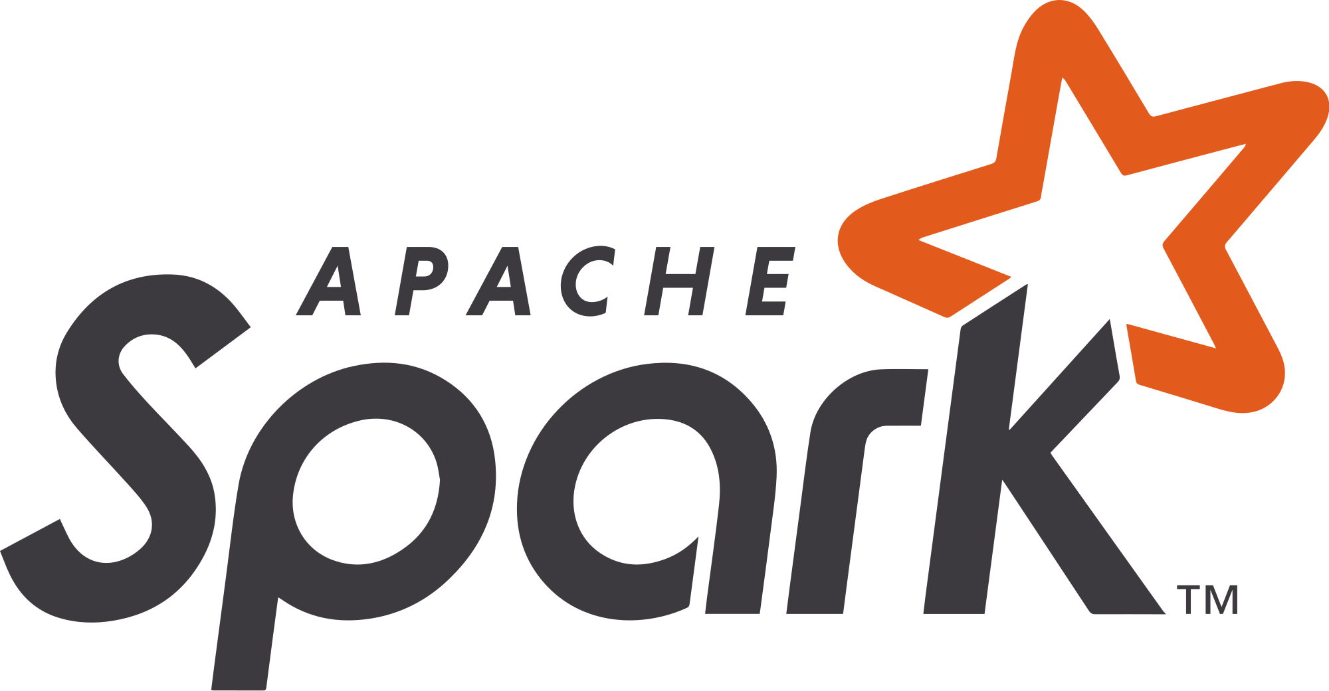




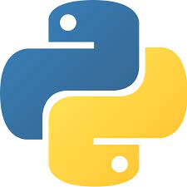












High Level Enterprise Data Architecture
Real-Time Data and Steaming Data
Real-Time / Steaming Data / Steaming Processing
Visualize, Interact, Self-Serve
Mob App
Social Data
Data Integration and Ingestion
Data Lake
Processing
Sensors
Edge
AI / ML
3rd Party Sources
Other Cloud Providers
Other Data Providers
Master Data Management
On-Prem Internal Data
Operational Database
Data Warehouse / Data Mart
Operations
CRM
ERP
Data Governance

Slide 13
COMPETITIVE DIFFERENTIATION
Intersection of key vectors
DATA LIFECYCLE | vs | SINGLE FUNCTION
HYBRID & MULTI | vs | CLOUD ONLY
SECURE & GOVERNED | vs | BASIC SECURITY
OPEN SOURCE | vs | PROPRIETARY LOCK-IN
PLATFORM | vs | POINT SOLUTION

Slide 14
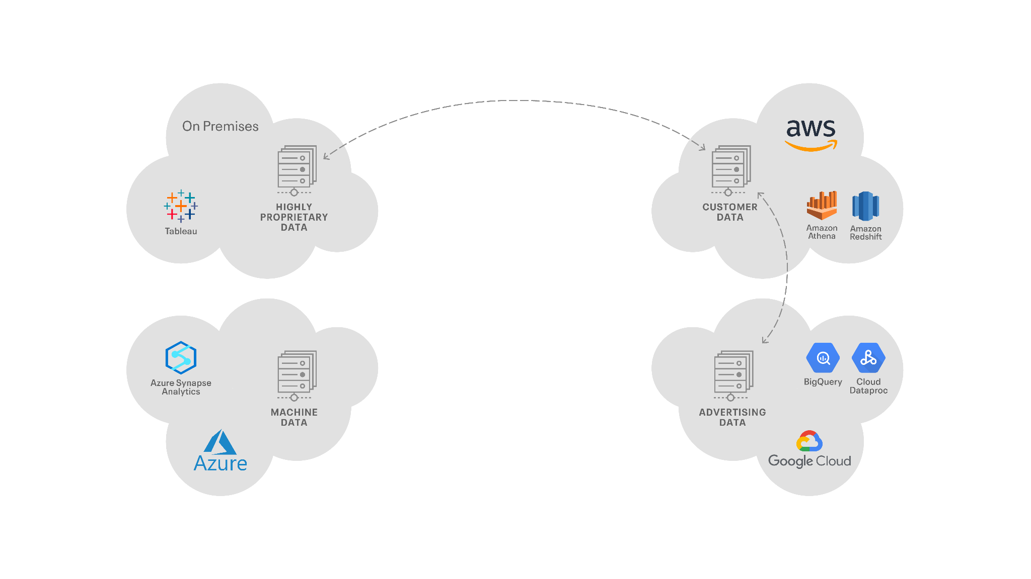
DISTRIBUTED DATA MANAGEMENT COMPONENTS
Which may run on multiple clouds and/or on-premises

Slide 15
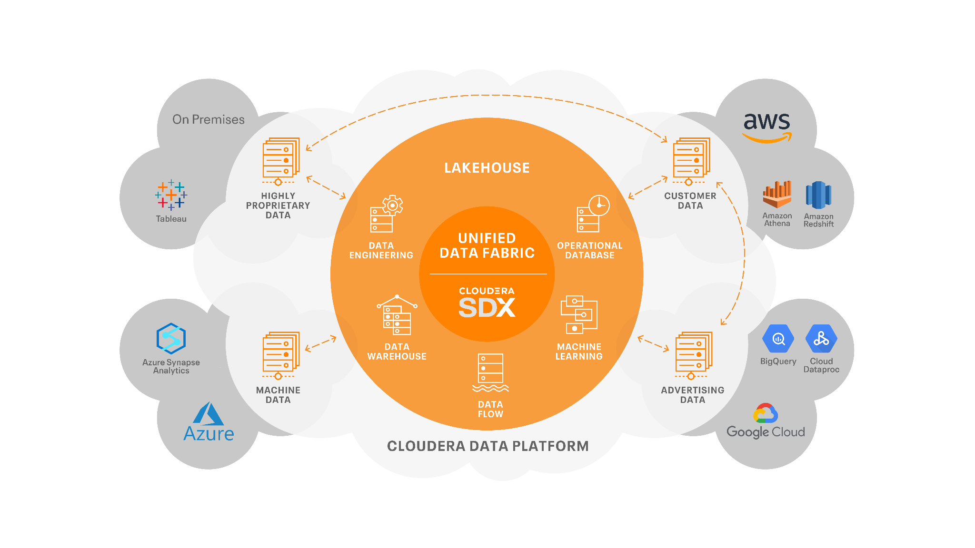
CLOUDERA’S HYBRID DATA PLATFORM
Portable | Interoperable | Open | Secure

Slide 16
CLOUDERA’S HYBRID DATA PLATFORM ENABLING MODERN DATA ARCHITECTURES
DATA LAKE
DATA FABRIC
DATA LAKEHOUSE
DATA MESH

Slide 17
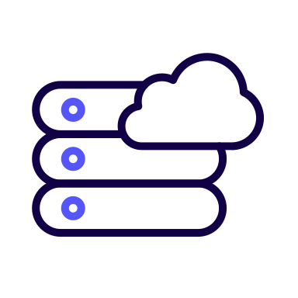


Cloudera Key Innovations in Our True Hybrid Platform
Strategic Priorities
Data in Motion
Open Data Lakehouse
Enterprise AI
DELIVER True Hybrid
ENABLE Modern Data Architectures
ACCELERATE Enterprise AI
Unified Data Fabric Security | Governance | Lineage | Observability
The Only True Hybrid Platform for Data, Analytics, and AI Public Clouds | On Premises

Slide 18

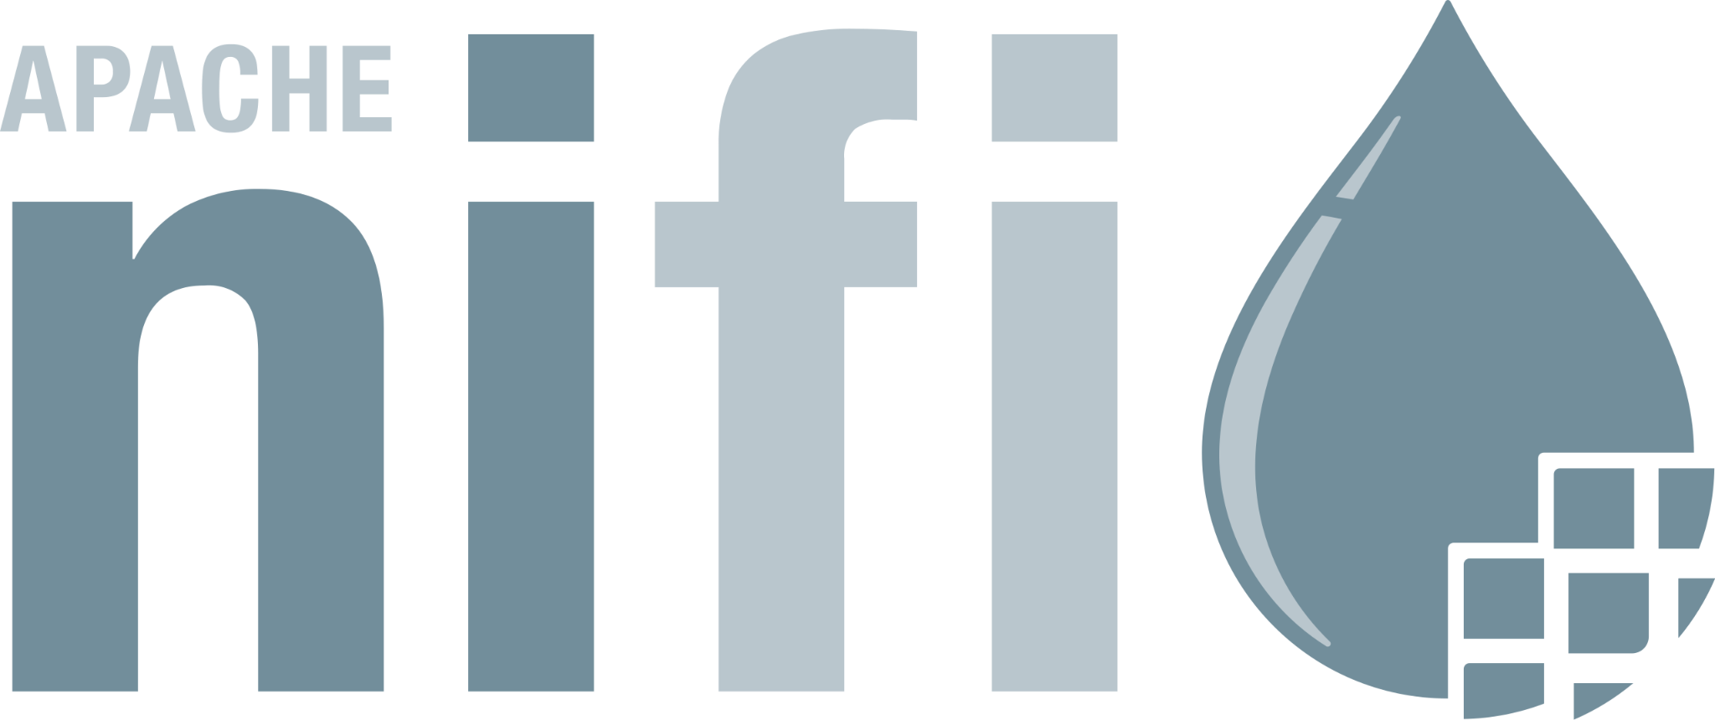
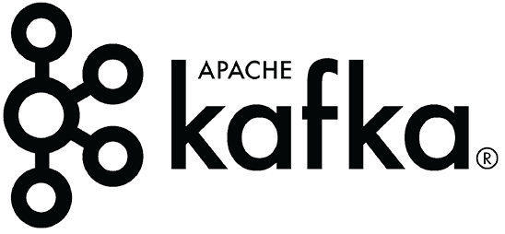
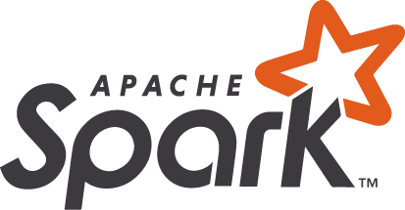





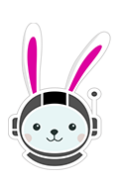
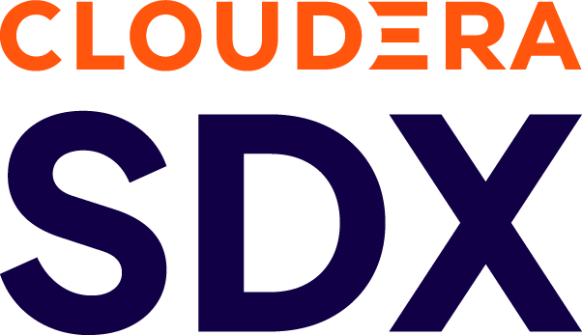

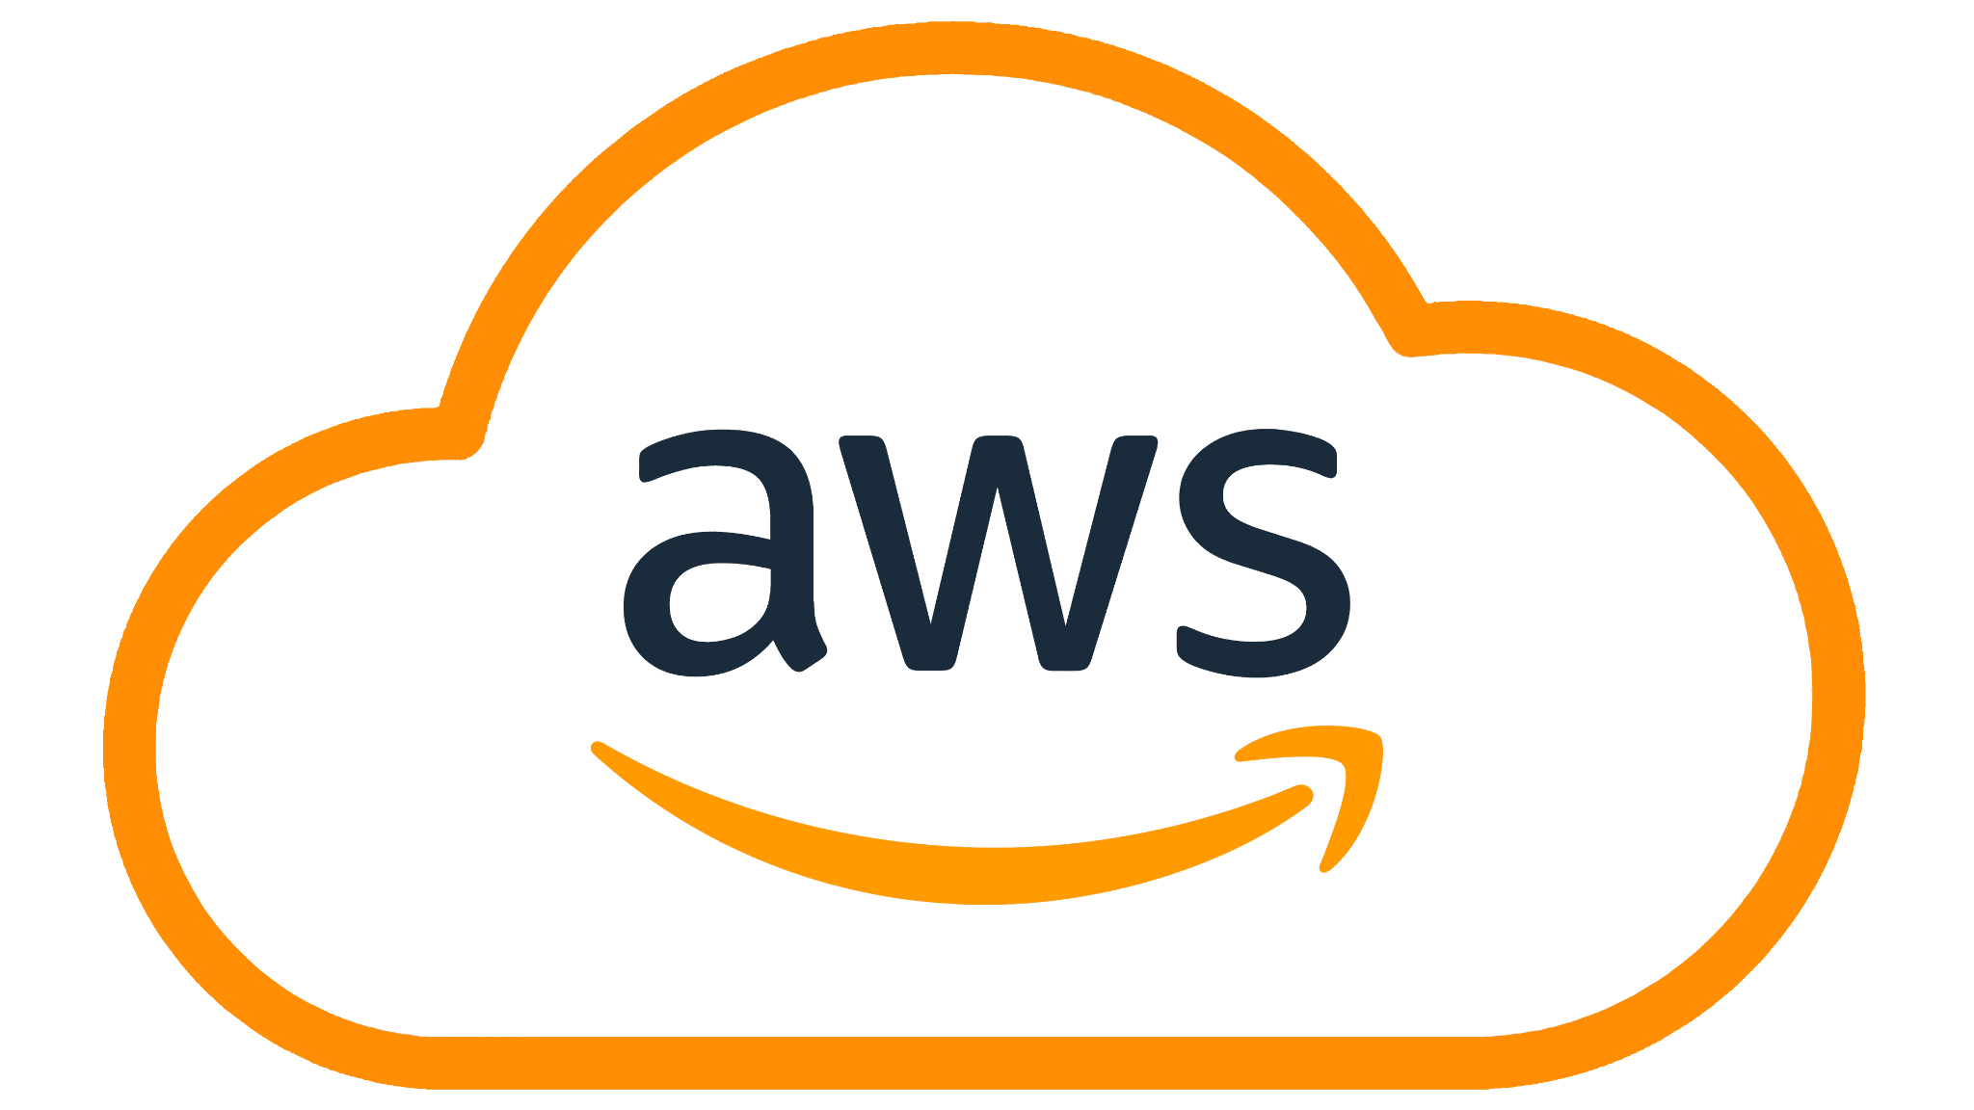
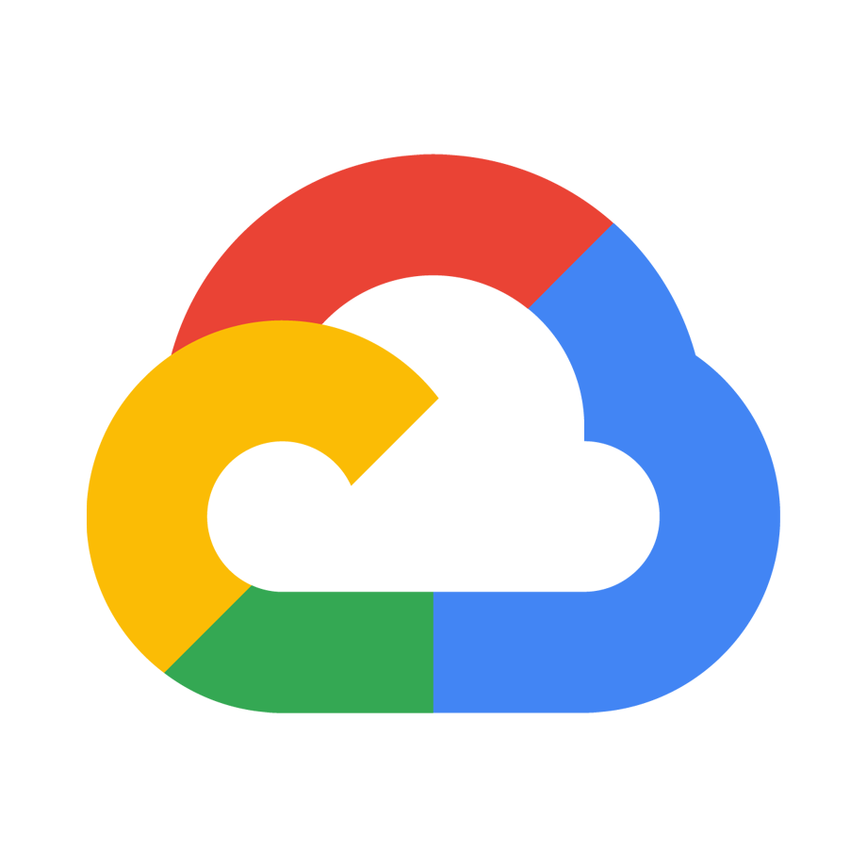
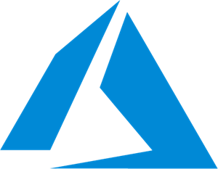



Cloudera Key Innovations in Our True Hybrid Platform
Data in Motion
Open Data Lakehouse
Enterprise AI
Strategic Priorities
DELIVER True Hybrid
ENABLE Modern Data Architectures
ACCELERATE Enterprise AI
Cloudera Data Flow
Cloudera Data Engineering
Cloudera Data Warehouse
Cloudera Operational DB
Cloudera AI Workbench - Inference - Agents
Unified Data Fabric Security | Governance | Lineage | Observability
The Only True Hybrid Platform for Data, Analytics, and AI Public Clouds | On Premises

Slide 19
INNOVATION | HYBRID
Transform any data anywhere into insights

Slide 20

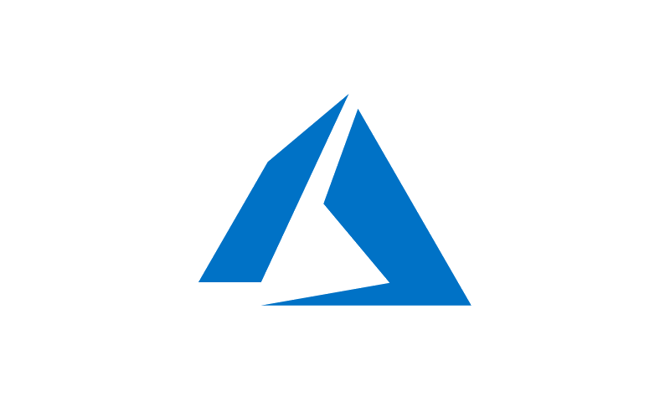

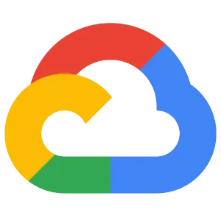



Our View of Hybrid
Hybrid
Freedom to move applications, data, and users bi-directionally between the data center and multiple public clouds without rewriting
Applications include streams, pipelines, databases, workspaces, and other data products
Data considerations include formats, schema, tags, policies, and other metadata
Users need to leverage existing skills and processes, while continuously modernizing

Slide 21





Hybrid Data Services
Data Services Look, Feel, and Act the Same in the Data Center and in the Cloud
Data
Flow
Data Engineering
Data Warehouse
Artificial Intelligence
Operational Database
Scalable, real-time data ingest, curate, and analyze data with an easy no-code approach to developing sophisticated streaming applications
Orchestrate, secure, and automate enterprise-grade data pipelines to accelerate time to insight with built-in job scheduling, interactive sessions, and visual troubleshooting.
Deploy easy-to-use data warehouses with high performance SQL engines for teams of business analysts that need sub-second query response times on petabyte scale data
Collaborative ML workspaces for data scientists to develop, experiment and deploy models into production with secure, self-service enterprise data access
High-performance NoSQL database with unparalleled scale and performance for business critical operational applications
Data Center
Data Center
Data Center
Data Center
Data Center
Cloud
Cloud
Cloud
Cloud
Cloud

Slide 22
INNOVATION | OPEN DATA LAKEHOUSE
Make smart decisions with a flexible platform that processes any data, anywhere, for actionable analytics and trusted AI.

Slide 23
A Data Lakehouse integrates and unifies the capabilities of a Data Warehouse and Data Lake, aiming to support AI, BI, ML and Data Engineering on a single platform.
Gartner’s Perspective
Exploring Lakehouse architecture & use case, Jan 2022

Slide 24
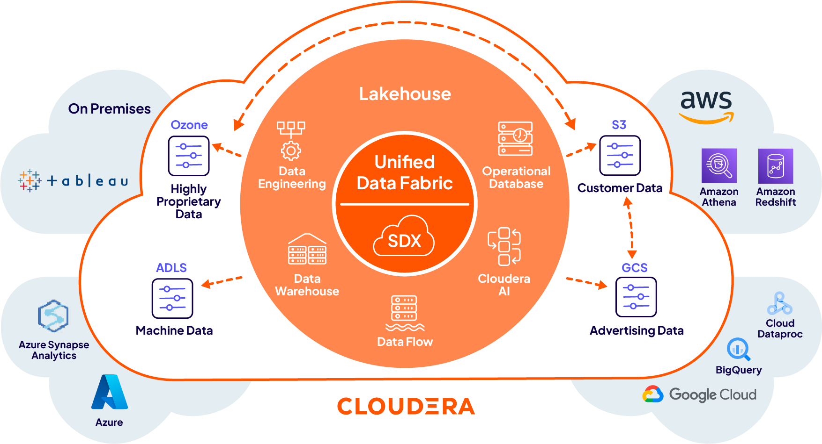
Data lake flexibility & data warehouse performance in a single platform.
Open data lakehouse helps organizations run quick analytics on all data - structured and unstructured at massive scale. It eliminates data silos and allows data teams to collaborate on the same data with the tools of their choice on any public cloud and private cloud.
This modern data architecture delivers data reliability with ease of data management. Run BI, AI, ML, streaming analytics on the same data without moving or locking your data ever.

Slide 25
Cloudera delivers the world's only open data lakehouse providing the following benefits:
OPEN ARCHITECTURE
EASE OF ADOPTION
MULTI-CLOUD
SECURE & GOVERNED
Cloudera’s data lakehouse powered by Apache Iceberg is 100% open—open source, open standards based, with wide community adoption. It can store multiple data formats and enables multiple engines to work on the same data.
By integrating Iceberg right into the Shared Data Experience (SDX), Cloudera offers the easiest path to deploying a lakehouse. Additional capabilities like schema evolution, hidden partition, and more simplify data management for large data sets.
Build a data lakehouse anywhere, on any public cloud or in your own data center. Build once and run anywhere without any headaches. Cloudera offers the same data services with full portability on all clouds.
The Iceberg tables in Cloudera integrate within SDX, allowing for unified security, fine-grained policies, governance, lineage, and metadata management across multiple clouds, so you can focus on analyzing your data while we take care of the rest.

Slide 26






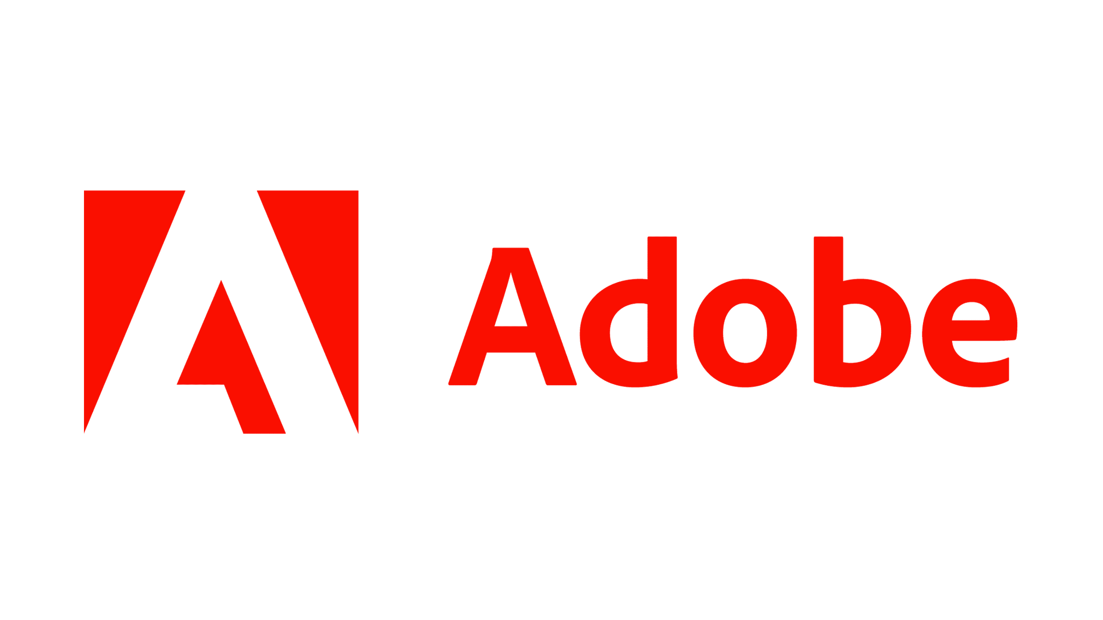

APACHE ICEBERG
A Flexible, Performant & Scalable Table Format
Donated by Netflix to the Apache Foundation in 2018
Flexibility
- Hidden partitioning
- Full schema evolution
Data Warehouse Operations
- ACID Transactions
- Time travel and rollback
Supports best in class SQL performance
- High performance at Petabyte scale

Slide 27
INNOVATION | DATA IN MOTION
Unlocking real-time intelligence

Slide 28
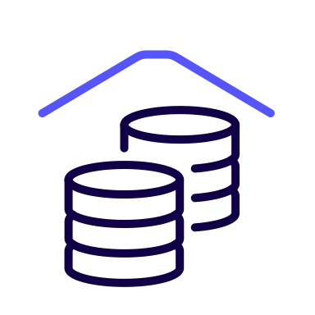


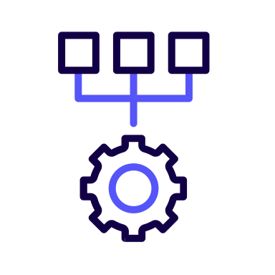



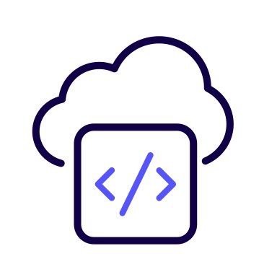
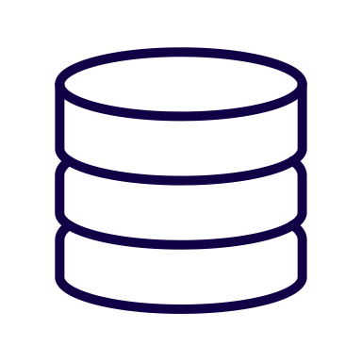


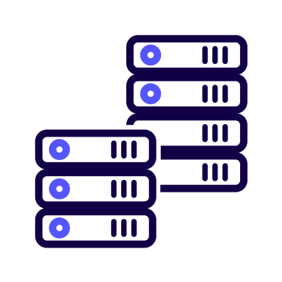
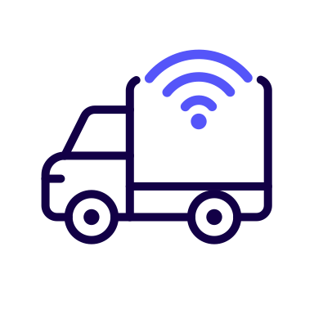

Why Do We Need a Data in Motion Architecture?
Rogue or “Spaghetti” Pipelines
Scalable Date in Motion Architecture
Application
Cloud DW
Cloud Storage
Date in Motion Architecture
Streaming Applications
Change Data Capture
Lakehouse
System Logs
ML/Data Science
Data Center On Prem
Edge Devices
Data Viz
Slow to insight
Duplication of data, transformation and movement logic
Lack of security and governance standards
Vendor/Data lock in
Difficult to make changes
Speed to insight
Efficient capture, processing, and distribution of any data anywhere
Integrated security and governance, full data provenance
Open architecture, maximum flexibility
Easy to modify as needs change

Slide 29

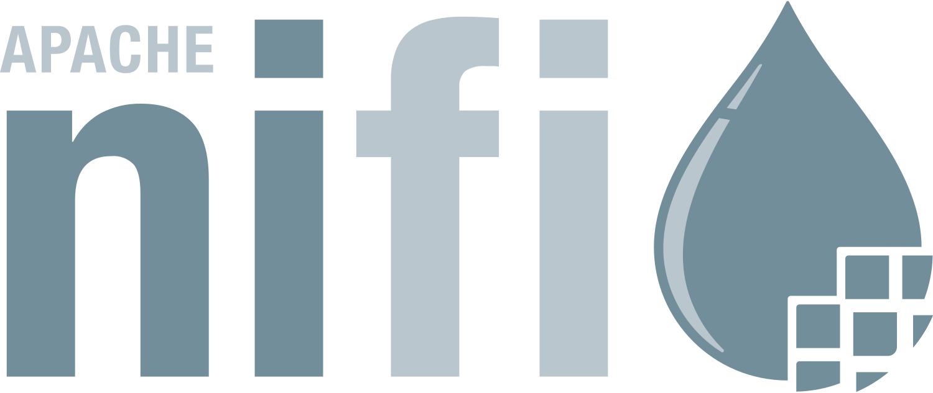
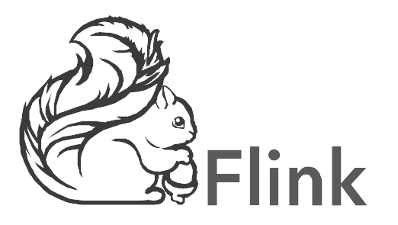
Streaming Data Pipelines with Cloudera
Cloudera Data Flow
Cloudera Stream Processing
Streams
Any Destination
Custom Kafka Producers
Operational Applications
Cloud DB SaaS Tools
Edge Devices
On Prem Apps/DB
Change Data Capture
Custom Kafka Producers
Custom Kafka Consumers
Analytical Applications

Slide 30
INNOVATION | ENTERPRISE AI
Train any model anywhere, securely and at scale

Slide 31
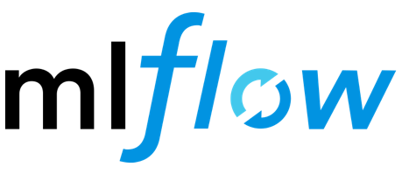







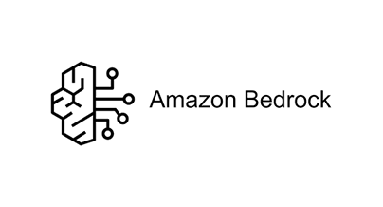
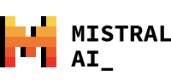


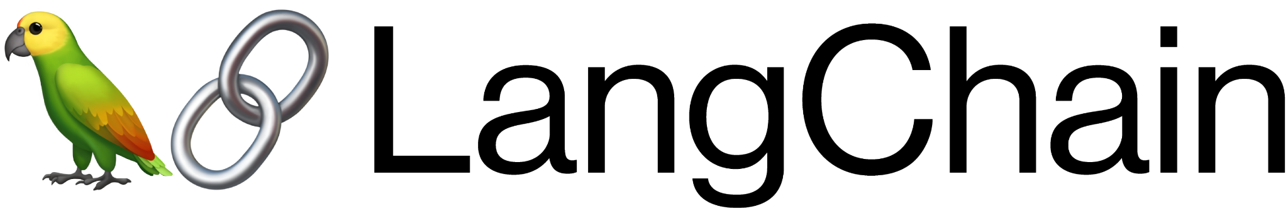


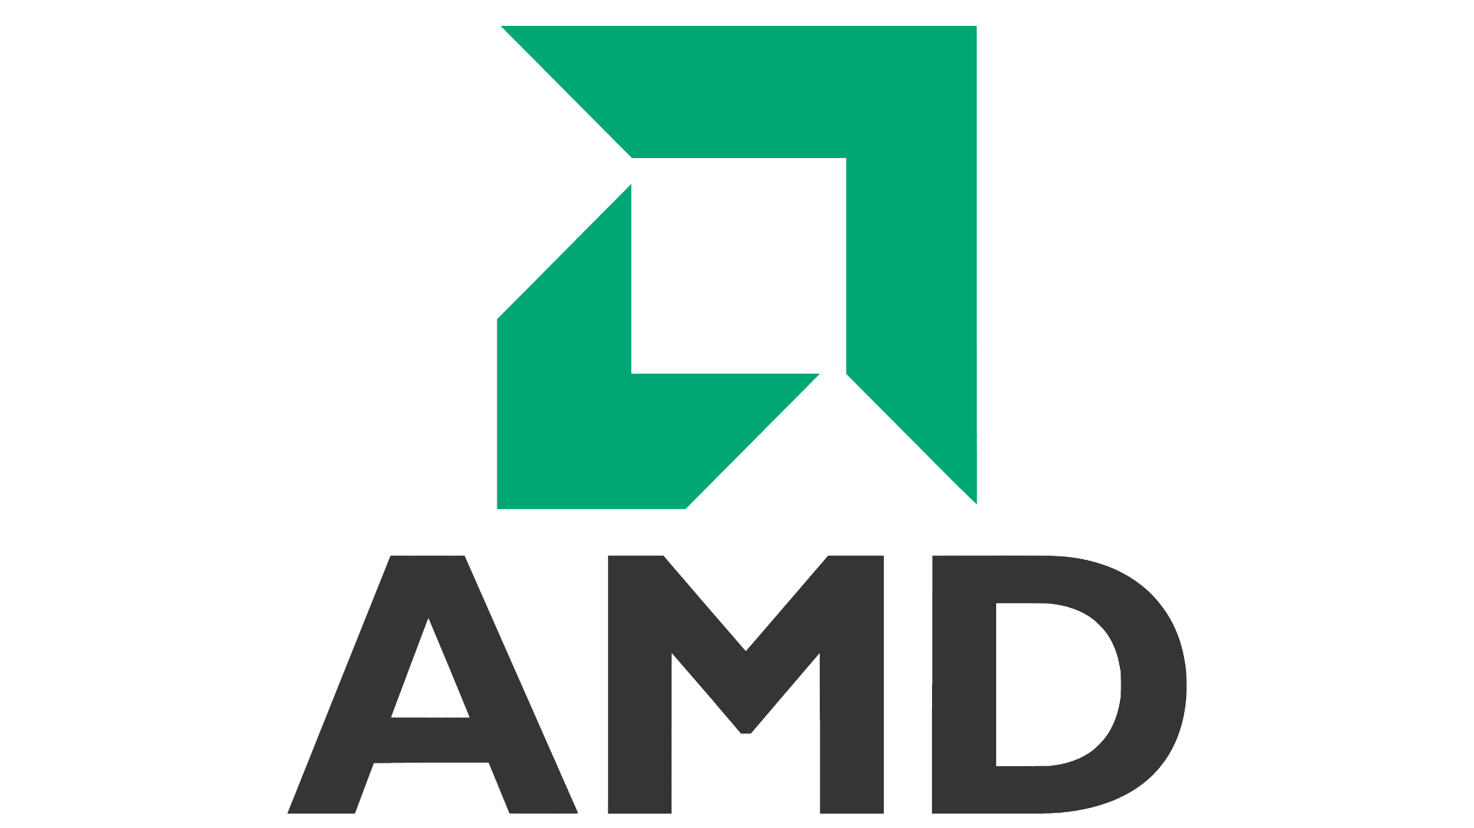

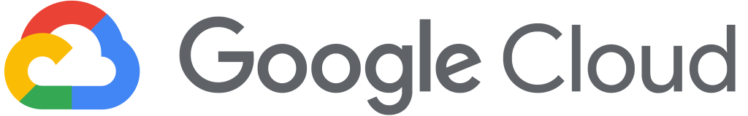
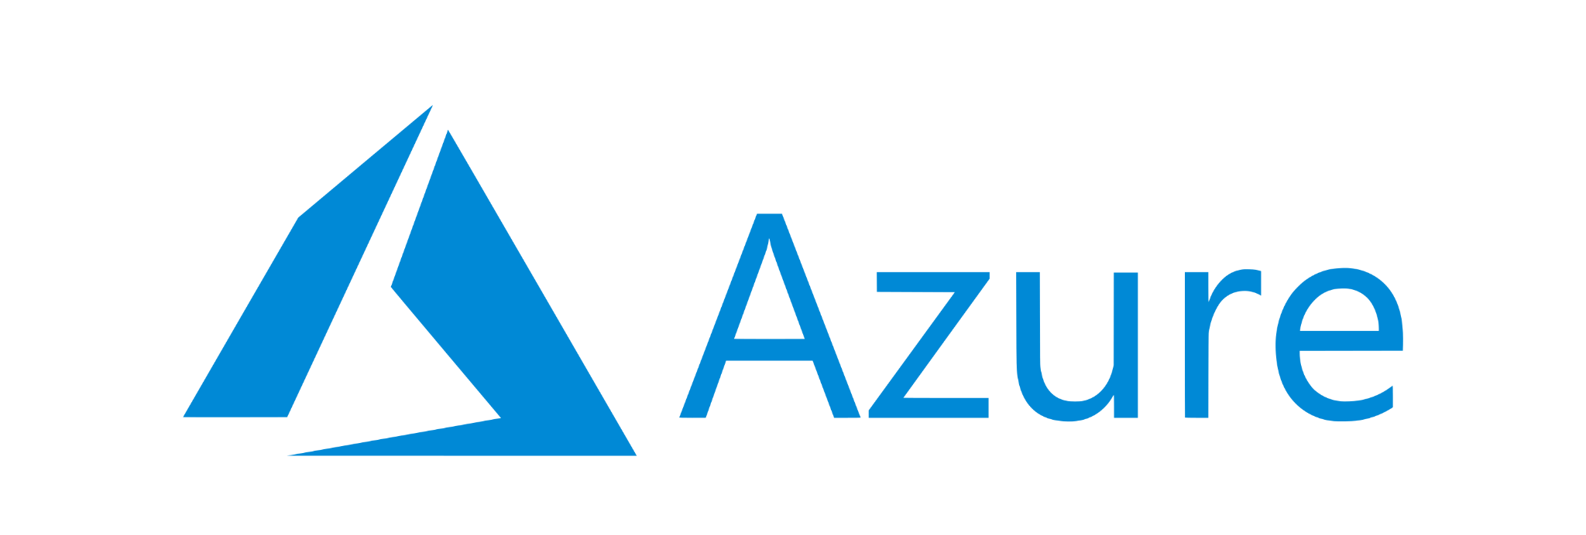





Cloudera AI Ecosystem
AI Applications & Agents
AI Workbench
AI Interference
AI Registry
AI Ecosystem
FRAMEWORKS
MODELS
VECTOR DATABASES
Real-time Open Data Lakehouse
Cloud Infrastructure
Hardware

Slide 32
Generative AI Value for Different Use Case Categories
55%
10x
12%
2X
20%+
Increase in Productivity
Faster
Content
Net Revenue Retention
Increase
Reduction in regulatory risk exposure
Cost
Savings
Source: The economic potential of generative AI: The next productivity frontier | June 14, 2023 | Report | McKinsey Digital

Slide 33

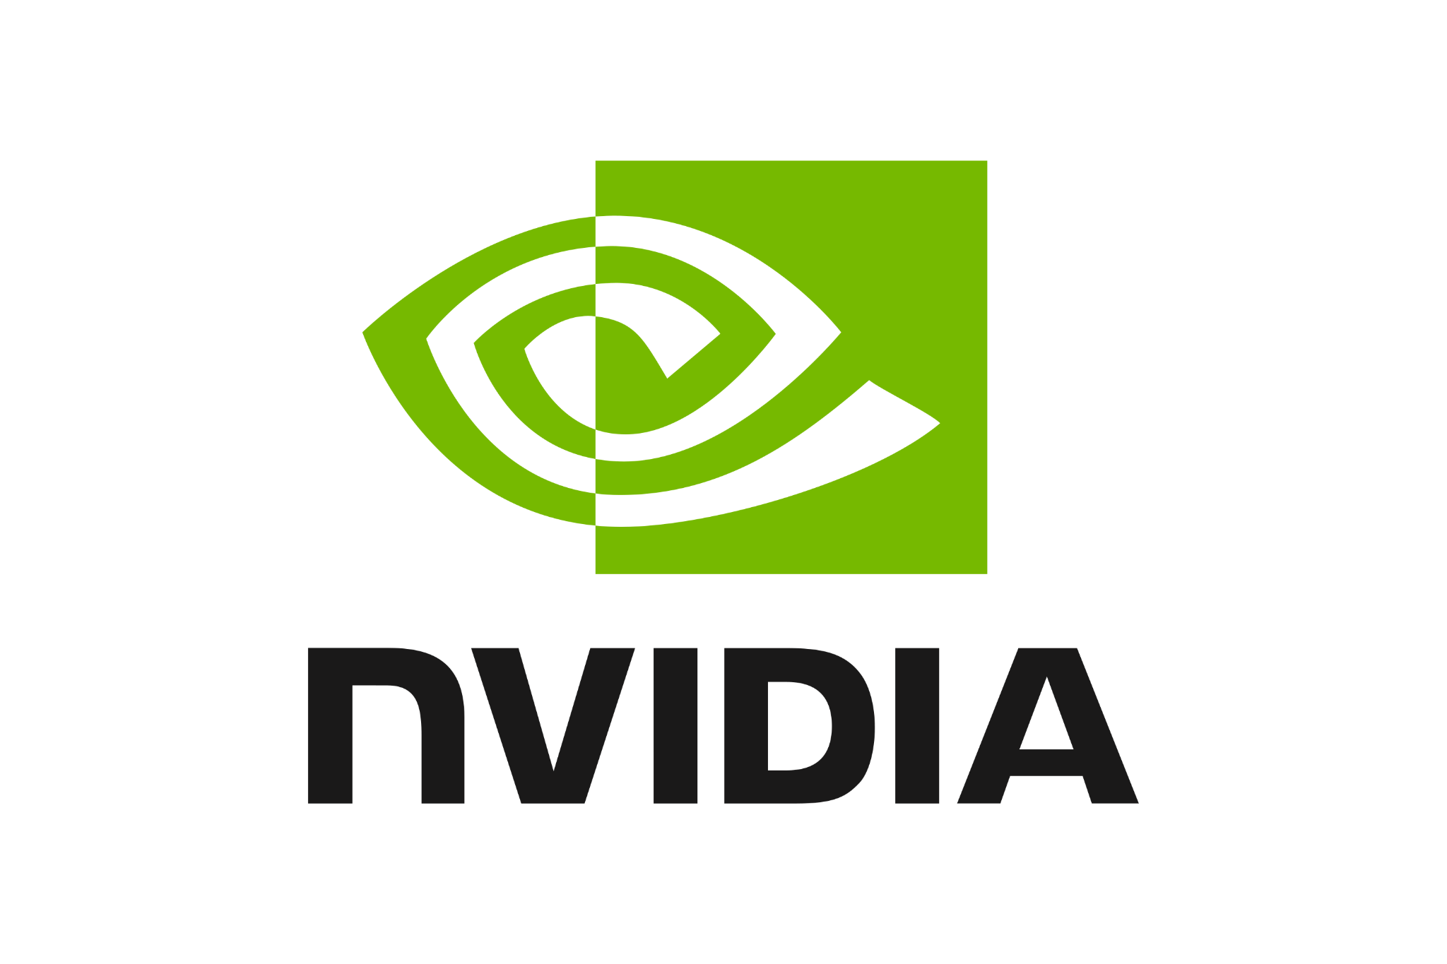




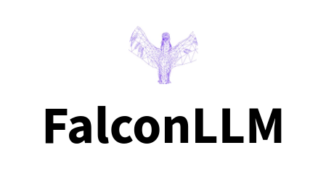
Cloudera AI Inference Service
Performance optimizations NVIDIA NIM provides up to 3.7x throughput increase for CPU-based inferences and up to 36x faster performance for NVIDIA GPU-based inferences.
Proprietary model access NVIDIA NeMo & optimized open-source models.
High availability and scalability Scale-to-zero autoscaling and HA for hundreds of production models.
Real-time monitoring Built in monitoring of the technical and algorithmic performance of the model.
Hybrid cloud and PaaS deployment support Run workloads on-premises, in the public cloud, or directly within a VPC.
Enterprise security Service Accounts, Access Control, Lineage and Audit.
AI Inference Service
API
Compatibility
HA and
Autoscaling
AI Apps
Hardware/ Software Acceleration
Enterprise
Security
Batch or Streaming
Business Intelligence
AI Registry
Cloudera
AI Assistants
On-Premises* & Public Cloud
* Tech preview for on-premises will be available 1HFY26

Slide 34
INNOVATION | OCTOPAI
Trusted by data teams to maximize data quality

Slide 35


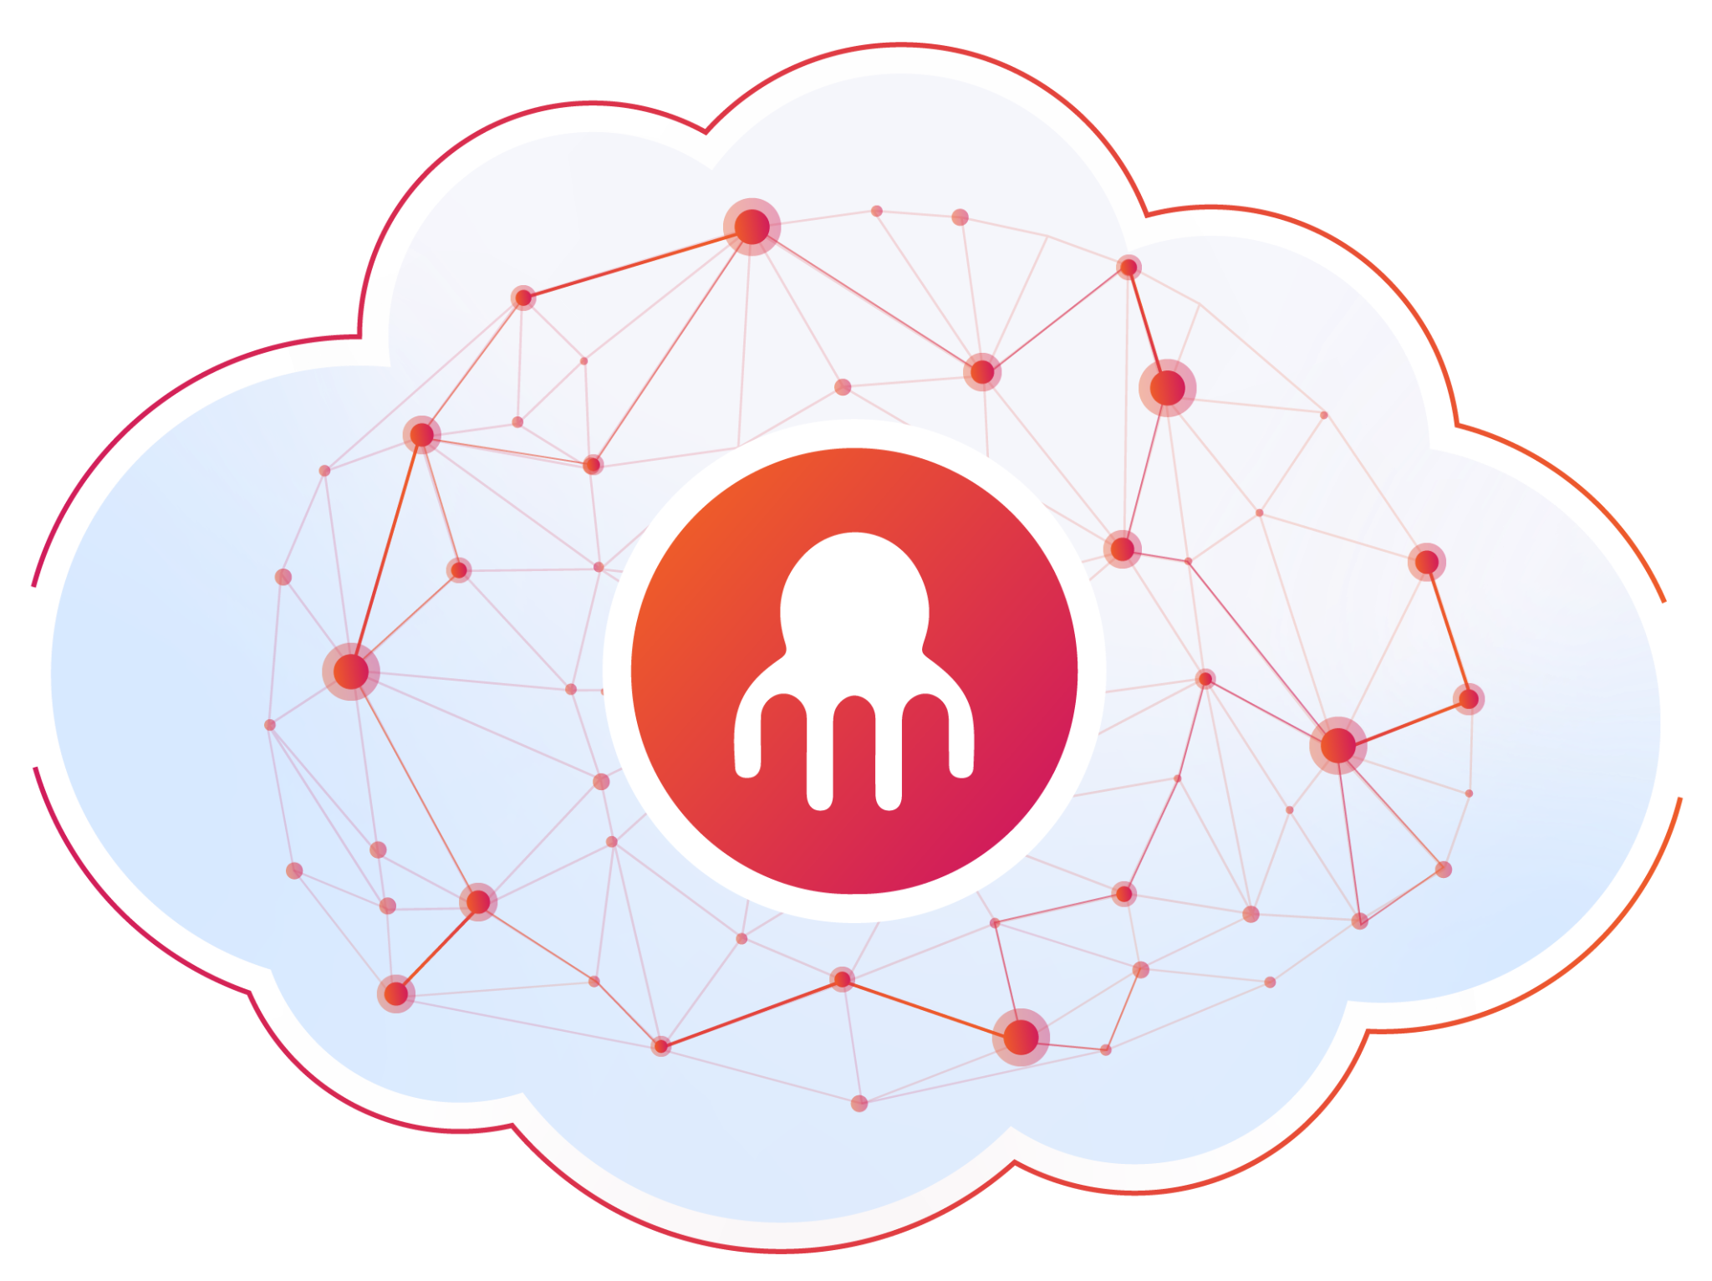








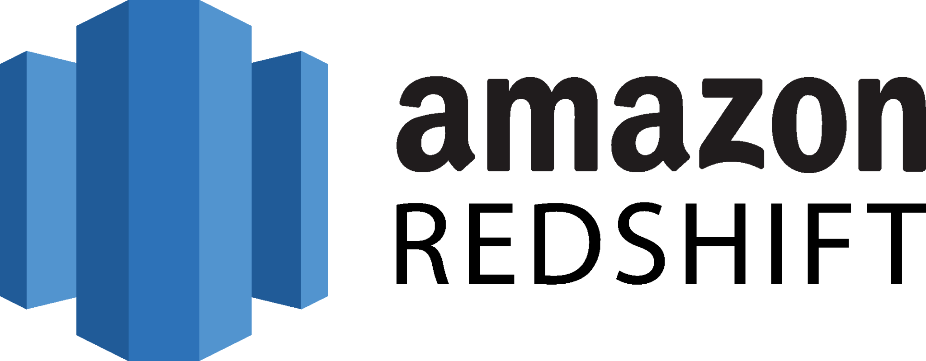

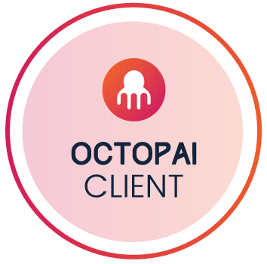

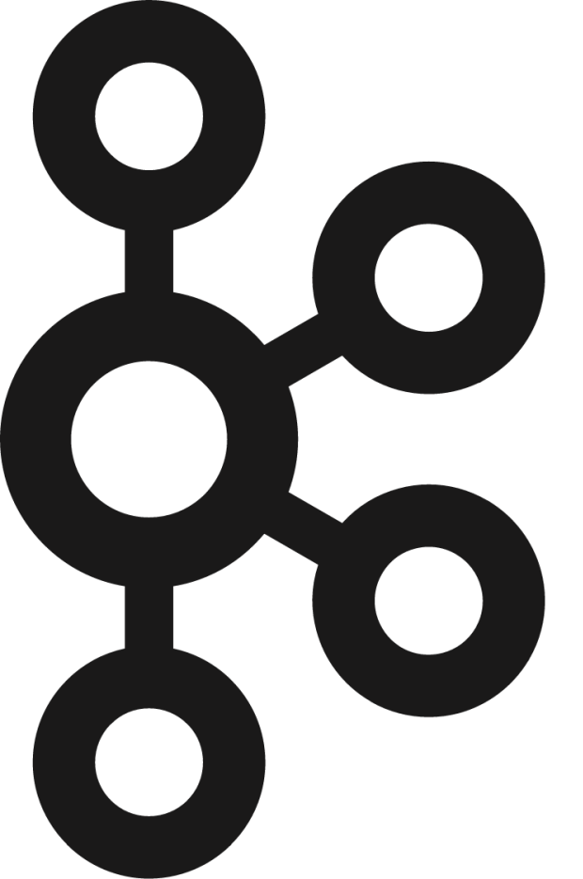






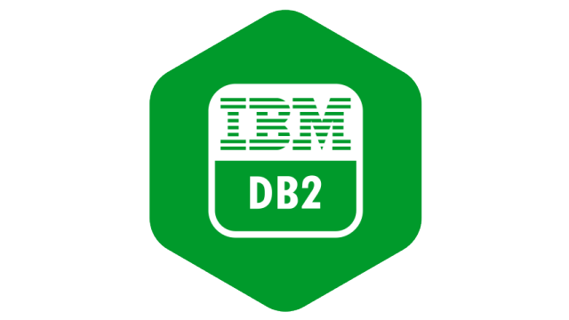



















Octopai as a Single Source of Truth for your Metadata
Octopai extracts metadata from all major data systems and maps the data flow automatically. Users can then explore and gain insights from the metadata graphs through a web application or partner vendors.
Scattered Data Landscape
Data Initiatives
Data Governance
Data Quality
Coming soon:
Data Privacy
Enriched Operational Metadata
Automated Raw
Metadata Extraction
Data Security
Octopai SaaS
Data Compliance
+60 Systems
​​DBs | ETLs | Code | Files
Dashboards | Reports
Data Discovery
Data Lineage
Data Knowledge Hub
Octopai AI
Data Transformation
Tech and Business Data Users

Slide 36




The Best-in-Class
Multi-Dimensional Lineage Platform
#1 Cross-System Lineage
Provides end-to-end lineage at the system level from the entry point, all the way to reporting, analytics and any data consumer
#2 Inner-System Lineage
Details the column-level lineage within an ETL process, report, or database object.
“4 months of manual mapping completed in 1 Day! As a new employee I was able to easily locate assets and plan the migration process”
Lead Financial Systems Analyst
Kelly Jenkins, FCSA
#3 End to End Lineage
End-to-end asset level lineage between systems from the source system into the end consumer.

Slide 37





The Ultimate 360° Metadata Management Platform
Data Discovery
Knowledge Hub
Locates relevant information for business use, analysis and insights across multiple data systems
Provides data teams with information about the various data assets available within a company
Automated data discovery to search in seconds and make informed data-driven decisions
Outstanding solution to increase BI teams' productivity
Self-creating and self-updating documentation
Built-in data lineage featured and collaboration
TOP USE CASES
TOP USE CASE
Changes implementation
Compliance with GDPR, CCPA, etc.
Fast, accurate business decisions
Real-time data inventory

Slide 38
Thank You!

